Slide 1
DAA MINI PROJECT
BY: ADITYA GIRI GOSWAMI (RA2011003011251)
ADITYA MISHRA (RA2011003011189)
SINHA SANJIV (RA2011003010833)

Slide 2
PROBLEM STATEMENT:
In daily share trading, a buyer buys shares in the morning and sells them on the same day. If the trader is allowed to make at most 2 transactions in a day, whereas the second transaction can only start after the first one is complete (Buy->sell->Buy->sell). Given stock prices throughout the day, find out the maximum profit that a share trader could have made.

Slide 3
ALGORITHM:
DYNAMIC PROGRAMMING APPROACH
1) Create an array profit[0..n-1] and initialize all values in it 0. 2) Traverse price[] from right to left and update profit[i] such that profit[i] stores maximum profit achievable from one transaction in subarray price[i..n-1] 3) Traverse price[] from left to right and update profit[i] such that profit[i] stores maximum profit such that profit[i] contains maximum achievable profit from two transactions in subarray price[0..i]. 4) Return profit[n-1]
To do step 2, we need to keep track of the maximum price from right to left side, and to do step 3, we need to keep track of the minimum price from left to right. Why we traverse in reverse directions? The idea is to save space, in the third step, we use the same array for both purposes, maximum with 1 transaction and maximum with 2 transactions. After iteration i, the array profit[0..i] contains the maximum profit with 2 transactions, and profit[i+1..n-1] contains profit with two transactions.

Slide 4
Algorithmic paradigm
Here, we are using Dynamic Programming approach to solve the above problem.
Dynamic Programming is a technique in computer programming that helps to efficiently solve a class of problems that have overlapping subproblems and optimal substructure property.
Dynamic programming is used where we have problems, which can be divided into similar sub-problems, so that their results can be re-used. Mostly, these algorithms are used for optimization. Before solving the in-hand sub-problem, dynamic algorithm will try to examine the results of the previously solved sub-problems.

Slide 5
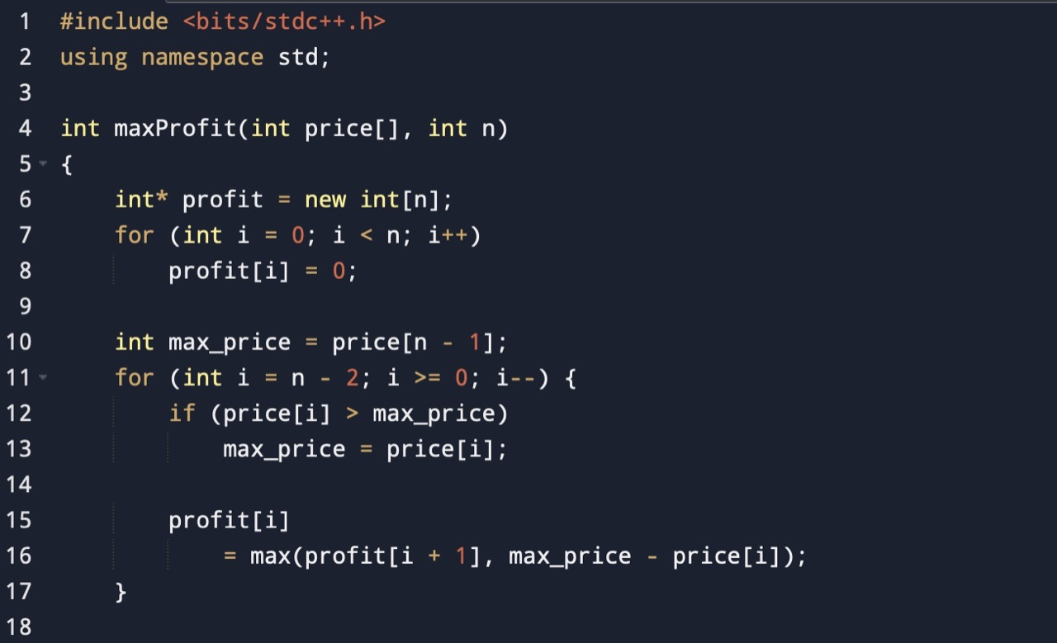
CODE:

Slide 6
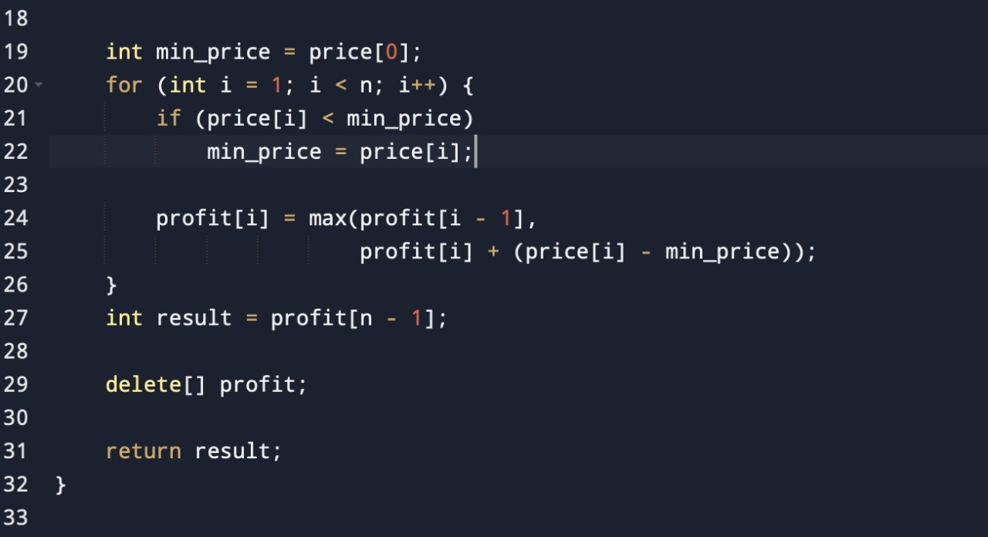

Slide 7
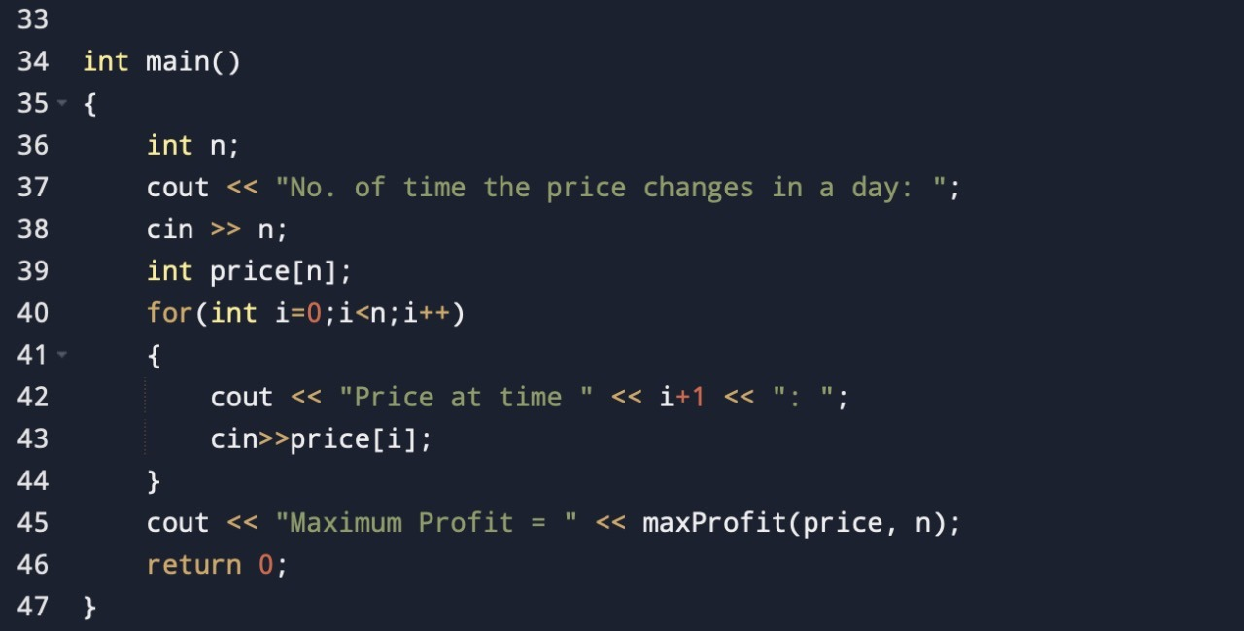

Slide 8
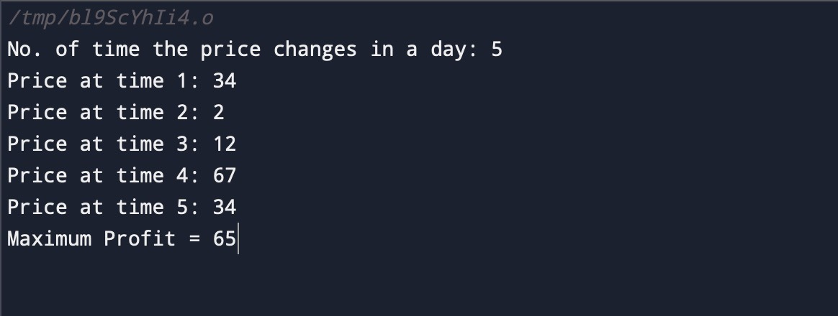

Slide 9
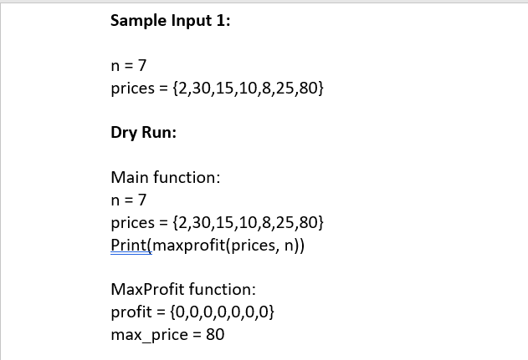
DRY RUN:

Slide 10
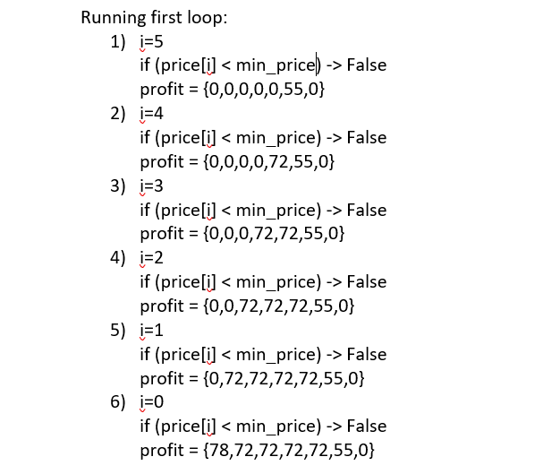

Slide 11
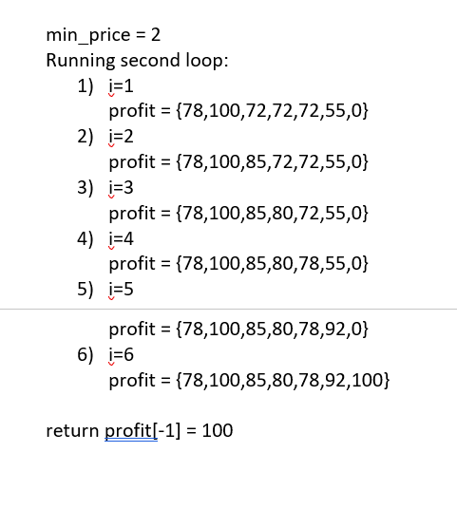

Slide 12
ANALYSIS:
In Dynamic programming problems, Time Complexity is the number of unique states/subproblems * time taken per state. In this problem, for a given n, there are n unique states/subproblems. For convenience, each state is said to be solved in a constant time. Hence the time complexity is O(n * 1).
Time Complexity: O(N)
Auxiliary Space: O(1)

Slide 13
Thank You

